Slide 1
SUPPORTING HOMELESS YOUTH: THE INTERSECTIONS OF HOUSING, WELLNESS, EDUCATION, & EMPLOYMENT
STATEWIDE CONFERENCE ON INTEGRATING SUBSTANCE USE, MENTAL HEALTH, AND PRIMARY CARE SERVICES
OCTOBER 2018

Slide 2
ROADMAP FOR TODAY
Focus of our talk:
Youth homelessness in SF
Larkin Street Programming: Behavioral Health integration in Learning Centers
Objectives:
(1) Discuss the barriers that young people experiencing homelessness face in pursing education and employment.
(2) Describe three approaches that can be utilized to address the physical and emotional wellness of young people experiencing homelessness.
(3) Explore the integration of these approaches into education and/or employment programming
Notes:
Natalie

Slide 3
WELCOME
Introduce yourself to your neighbor. Consider sharing some of the following:
Name
Pronouns
Organization you work for, population you serve, and role
What brings you to this workshop?
Notes:
Shellena
Do introductions. If small group name, org., pronoun, ice breaker question.
If large group shout out profession- Psychiatrist/Psychology, corrections, Drug & Alcohol counselors, Clinicians, Nurses

Slide 4
WHAT CAUSES YOUTH HOMELESSNESS?
Notes:
Shellena Make icebreaker!
Abuse and conflict with a parent or guardian are common drivers into homelessness for young people.
These issues are particularly acute for LGBTQ young people
A disproportionate number of young people experiencing homelessness have a history of involvement in the child welfare system.
The relationship is complex – children whose parents have been homeless are more likely to enter, and a history of involvement in the system makes one more likely to experience homelessness after exiting
Involvement in the justice system can also increase a young person's likelihood of becoming homeless
And, many laws disproportionately affect homeless people, making them more likely to become involved.
Bay Area housing costs are among the highest in the country, leaving many families precariously housed and at greater risk for homelessness.
Unemployment compounds the impacts of the affordability crisis
Family economic instability disproportionately impacts youth of color and their families

Slide 5
WHAT CAUSES YOUTH HOMELESSNESS?
Abuse and conflict with a parent or guardian
Involvement in the child welfare and criminal justice systems
A worsening affordability crisis compounded by unemployment
… and these factors disproportionately impact youth of color and youth who identify as LGBTQ
Notes:
Shellena
Make icebreaker!
Abuse and conflict with a parent or guardian are common drivers into homelessness for young people.
These issues are particularly acute for LGBTQ young people
A disproportionate number of young people experiencing homelessness have a history of involvement in the child welfare system.
The relationship is complex – children whose parents have been homeless are more likely to enter, and a history of involvement in the system makes one more likely to experience homelessness after exiting
Involvement in the justice system can also increase a young person's likelihood of becoming homeless
And, many laws disproportionately affect homeless people, making them more likely to become involved.
Bay Area housing costs are among the highest in the country, leaving many families precariously housed and at greater risk for homelessness.
Unemployment compounds the impacts of the affordability crisis
Family economic instability disproportionately impacts youth of color and their families

Slide 6
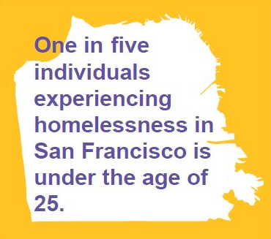
HOMELESSNESS IN SF
California is home to the highest number of young people experiencing homelessness in the country
On a given night 1,363 young people are on the streets of San Francisco without a safe place to sleep
Just six cents of every dollar spent on homeless services in San Francisco is directed towards youth
Notes:
Natalie
In California over 15,000 young people are homeless on the streets without a safe place to sleep on any given night.
(This doesn't encompass those couch surfing, living in cars or abandoned buildings, or participating in the street economy in exchange for a place to sleep)
These young people are more likely to be both unsheltered and underage than their peers in other states.
The State lacks the resources and collaboration needed to meet the needs.
In San Francisco, the need vastly outstrips demand. On a given night there are 1,363 young people on the streets without a safe place to sleep.
And we know the cost – 50% of all people experiencing homelessness in SF had their first experience of homelessness before the age of 25.
Ending youth homelessness is preventing the next generation of chronically homeless adults
Despite the need, just a fraction of the $$ spent on homeless services in the city is directed towards youth.
There are only 450 youth-specific transitional or supportive housing beds citywide, with fewer than 100 more in development.

Slide 7
WHAT BARRIERS DO YOUNG PEOPLE EXPERIENCING HOMELESSNESS FACE?
Poor health and wellness
Interrupted life skills development
Disconnection from education and employment
Lack of supportive relationships with adults
Notes:
Natalie
Youth homelessness is different from adult homelessness not only because the causes are different, but because young people are still developing into adulthood
These are common challenges than can result from or be exacerbated by an experience of homelessness.
Poor health and wellness, including physical health, mental health, and substance use
Interrupted life skills: many young people enter homelessness without the opportunity to develop the basic life skills needed to navigate adulthood: maintaining a lease, addressing health concerns, engaging and persisting in education, obtaining and retaining employment, and managing and growing income.
Housing costs in Bay Area are unattainable for many.

Slide 8
OUR MISSION
To create a continuum of services that inspires youth to move beyond the street.
We will nurture potential, promote dignity, and support bold steps by all.
LARKIN STREET YOUTH SERVICES
Notes:
Shellena
Larkin Street began in 1984 as a drop in center to address the needs of young people experiencing homelessness in the Polk Gulch neighborhood.
35 years later, we are the largest provider of services to homeless youth
Full continuum of services, from street outreach and emergency shelters, to housing, case management, education, employment, and health services.
Our vision is to not interrupt youth homelessness, but to end it.

Slide 9
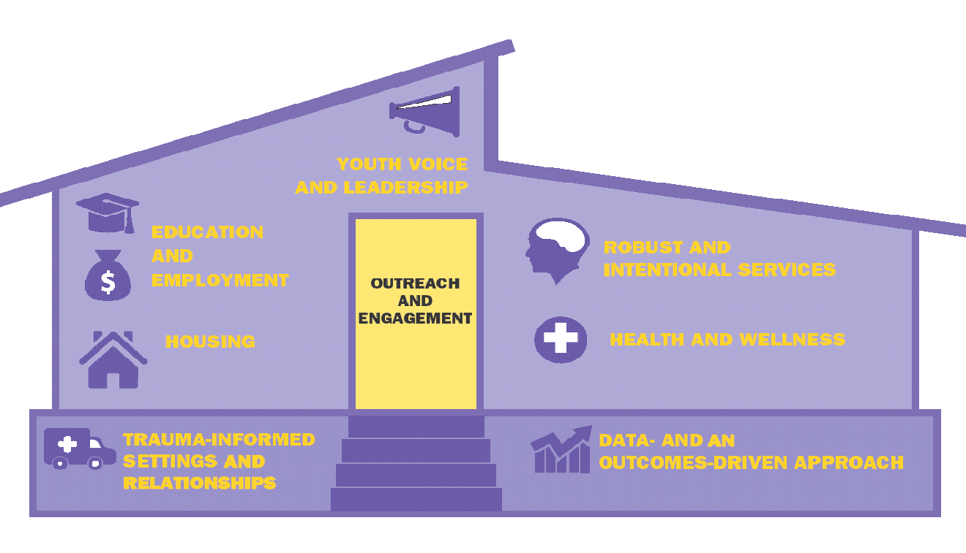
LARKIN STREET’S CONTINUUM
Notes:
Shellena
Larkin Street Service Model
Helping young people off the street requires a continuum of services that build off one another.
From the entry-points of outreach and engagement to education and employment services that promote long-term self-sufficiency, the “house” exemplifies the Larkin Street model.
House vs Path: In the past we’ve conceptualized our services as a path young people follow, from street life to stability.
The reality is the journey is non-linear, and more about building upon an increasingly stable foundation in order to achieve a self-sufficient, well-rounded life, than a linear path.
Trauma informed settings and relationships, and data and an outcomes-drive approach are the foundation of our work
Outreach and engagement services are the entryway / door into services
Housing and Wellness – first floor
Robust and intentional services
Education and Employment – second floor
Youth voice and leadership – the roof

Slide 10
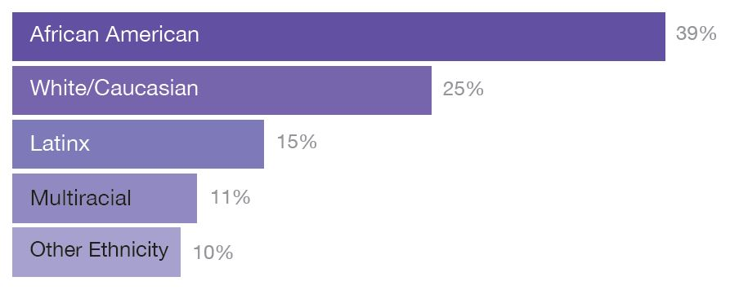
2,500 YOUTH WALK THROUGH OUR DOORS EACH YEAR
Over half are Bay Area natives
They are mostly youth of color
Many identify as LGBTQ
Notes:
Shellena
Over 2,500 young people access Larkin Street's services every year.
These youth are largely youth of color and LGBTQ.
These youth are at a greater risk of homelessness than their white / cis peers, because the drivers into homelessness disproportionately impact them.
For example, African Americans make up 7% of the general population in the Bay Area, yet 40% of our client base.
Similarly, 6% of the Bay Area identify as LGBTQ, and 31% of our clients do.
The majority are from the Bay Area, with 31% born in San Francisco – a homegrown problem.

Slide 11
YOUTH OUTCOMES
Among youth exiting our housing programs last year…
83%
87%
67%
exited to stable housing
were employed or enrolled in college
achieved physical and emotional wellness
Notes:
Shellena
Our model supports long-term outcomes in the domains of housing, physical and emotional wellness, living wage employment, and post-secondary education.

Slide 12
BEHAVIORAL HEALTH DEPARTMENT
Notes:
Shellena
Overview, vision, collaboration
- Philiosphy- TIC, Harm Reduction, Restorative Justice
Harm reduction- safe shooting kits, shar
We want to be were youth are which is in programs.
Clinicians at the various program sites, working evening hours, and collaborating with staff.
Individual therapy
Groups
Raising Awareness
Meet & Greet

Slide 13
BEHAVIORAL HEALTH CONCERNS
At intake
2/3 report experiencing a mental health issue such as serious depression or aniety in the 30 days prior to intake
44% report attempts to stop using
At entry to housing,
47% report current or prior mental health issues
29% report current or prior illicit substance use
Youth who report current or prior substance use or mental health issues at entry are less likely to reach outcomes by the time they exit
Notes:
Shellena
We know trauma/stress and substance use can alter a young person's brain functioning, impacting learning, causing behavioral problems, and preventing maintaining employment.
88% of young people reported experiencing some form abuse (physical, sexual, or emotional) prior to becoming homeless.
(source: 2015 SF Homeless Unique Youth Count & Survey)
Stats- clients reporting current or prior MH issues
47% of our clients report current or prior mental health issues at entry to housing (source: FY1617 annual stats)
29% report current or prior illicit substance use (source: external evaluation data from 1/2015 – 12/2017, reported at entry to housing – excludes alcohol, nicotine, marijuana)
Current or prior SU:
- 61% less likely to exit to stable housing,
- 60% less likely to be able to manage financial obligations at exit from housing,
- 61% less likely to be enrolled in education or employed at time of exit from housing
Current or prior MH issues:
- Self reported overall MH at entry to housing – Poor 2%, Fair 24%, Good 39%, Very Good 22%, Excellent 13%
- 50% more likely to be able to manage financial obligations at exit from housing with every 1 point increase in self-reported mental health at entry
Avergae age at first use: 15.6 years
Most use alcohol and marijuana
(source: external evaluation data from 1/2015 – 12/2017, reported at exit from housing)

Slide 14
IMPACTS OF BARRIERS ON EDUCATION AND EMPLOYMENT
Gaps in education
Lack of employment history
Difficulty establishing routines or making appointments
Difficulty navigating systems and structures
Notes:
Natalie

Slide 15
LEARNING CENTERS
Notes:
Natalie

Slide 16
LEARNING CENTERS
Justification | Structure | Barriers
40% of transition aged youth do not have a high school diploma or GED, compared to 8% of the general population. (2015 PIT) 54% of school aged youth were not attending school at entry into Larkin Street housing. (FY1516 LS) | 4 months, 16 weeks (used to be 6 mo) 25-30 hours per week of instruction Incentives – dependent on attendance ($150/wk, $300/mo) Harm Reduction Model Wrap around services and support Industry based instruction (Technology, Healthcare, Arts) Experiential Learning | Stable housing Substance use Mental health Financial literacy Lack of additional academic support Client engagement & accountability Post-exit follow-up and aftercare
Other Programming: Bridge Academy (10 Weeks) Employment Training Program (5 Weeks), internships, GED tutoring | Outcome goal: 60% of youth who complete a Learning Center program will have significant education or employment gains. | Successful outcome: enroll in College, obtain employment, 2 GE improvement, or enroll in additional programming
Notes:
Natalie

Slide 17
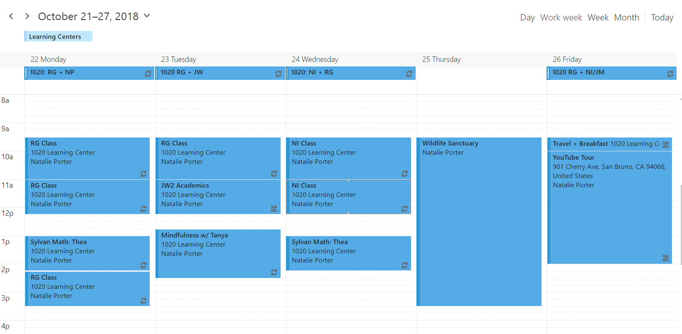
LEARNING CENTERS
Notes:
Natalie
Daily schedule

Slide 18
BEHAVIORAL HEALTH INTERVENTIONS IN LEARNING CENTERS
Mindfulness
Restorative Practices + Motivational Interviewing
Behavioral Health Staff Meet & Greets
Collaborative Case Conferences
Notes:
Natalie
Specific initiatives – restorative practices (restorative circles, restorative justice), mindfulness, motivational interviewing, experiential learning; collaborative case conferences; how we integrated

Slide 19
Notes:
Mindfulness video

Slide 20
LEARNING CENTER OUTCOMES
Youth report mindfulness sessions helped them…
Gain skills to deal with stress and conflict (100%)
Use tools to get into a calm, relaxed, and focused mindset (100%)
Become more open to accessing therapy or other types of emotional support (60%)
Among Learning Center participants last year, 100% made significant education or employment gains, including enrolling in post-secondary
Notes:
Natalie
Client feedback on mindfulness from Tech LC survey (5 respondents)
Private funding outcomes for Learning Centers – data from FY1718 (7 youth completing)

Slide 21
IN PRACTICE…
Notes:
Shellena
Group activity

Slide 22
DISCUSSION
What stood out to you from the activity?
Was there anything that surprised you?
In what ways can you be more mindful in the way you respond to the individuals you work with?
Notes:
Both!
The activity was meant to give you information on how instructors navigate through the housing, wellness, education, & employment needs of our youth.
Building rapport
Housing concerns
DV
Behavioral concerns
Conflict with peers
Collaborative case conference
Therapy
Each response we make leads to a decision or choice made by the youth
There is no complete right/wrong way to go about helping. If you allow the youth to lead then they will guide you to what they want. Even if you were to respond in a way that did not lead to a favorable response you still learned something. And can try again.
Be mindful to allow your clients to have autonomy to make their own choices
They are driving and we are sitting in the passenger seat and sometimes maybe in the back seat providing support.

Slide 23
Shellena Eskridge
Director of Behavioral Health
Larkin Street Youth Services
seskridge@larkinstreetyouth.org
www.larkinstreetyouth.org
Natalie Porter
Manager of Education, Learning Centers
Larkin Street Youth Services
nporter@larkinstreetyouth.org
www.larkinstreetyouth.org
Notes:
Questions?

